Slide 1
Introduction to Neural Network

Slide 2
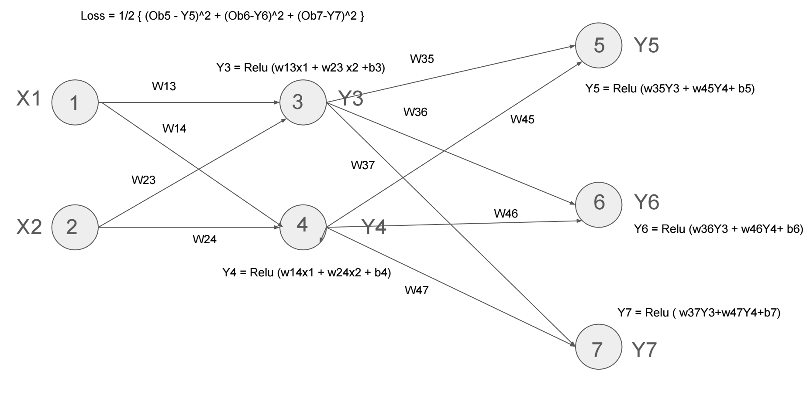

Slide 3
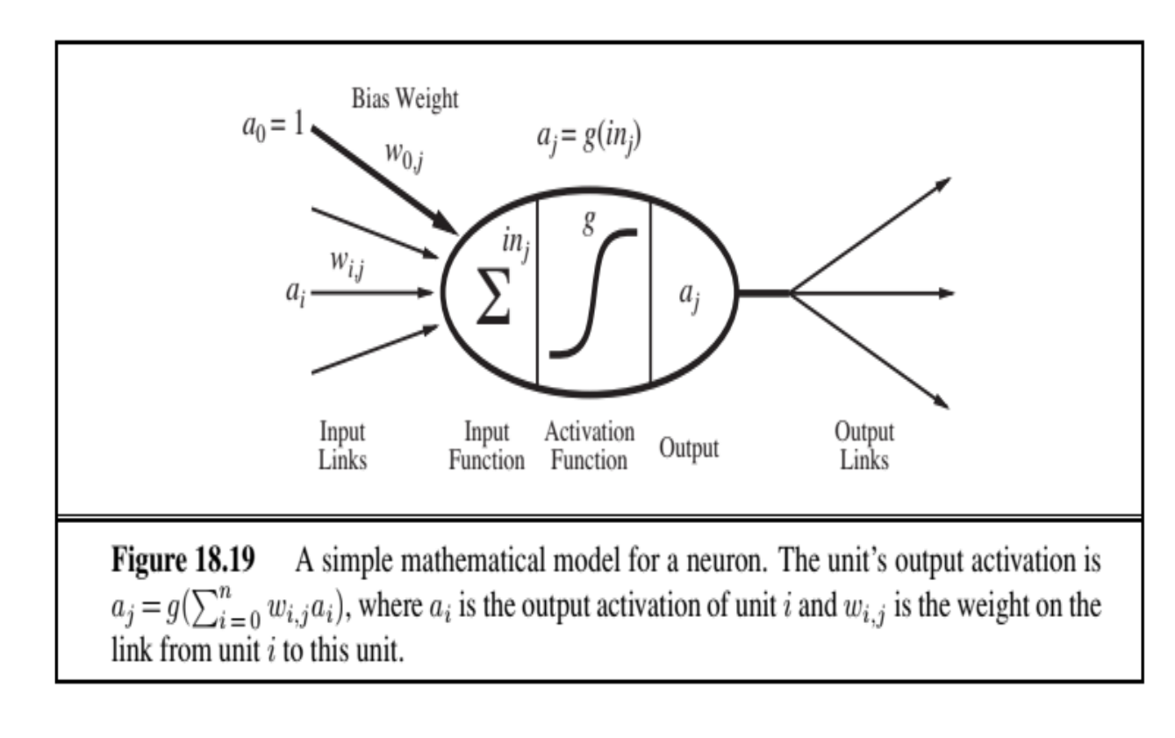
a₁
w_{1j}
In_{j}
= a₁w_{1j} + a₂w_{2j} + …….+ a_{i}w_{ij} + ……+a_{n}w_{nj}
a₂
w_{2j}
a_{i}
w_{ij}
w_{0j}
a_{j}
= g (In_{j} )
w_{nj}
a_{n}

Slide 4
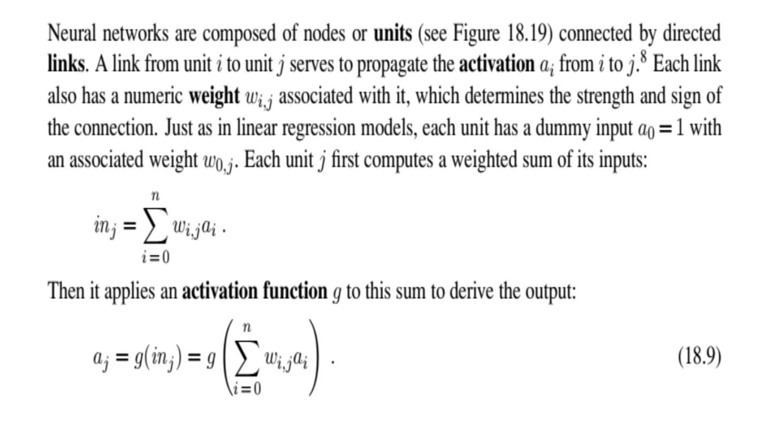

Slide 5
Feedforward neural network
Directed acyclic graph. Only forward connection, no
feedback loop. Output depends on current input and
weights of the network
Recurrent neural network
Feedback connection is available. Output depends on
input and previous state. Suitable for short term
memory
A single neuron acts as a linear classifier and can implement only linearly separable function

Slide 6
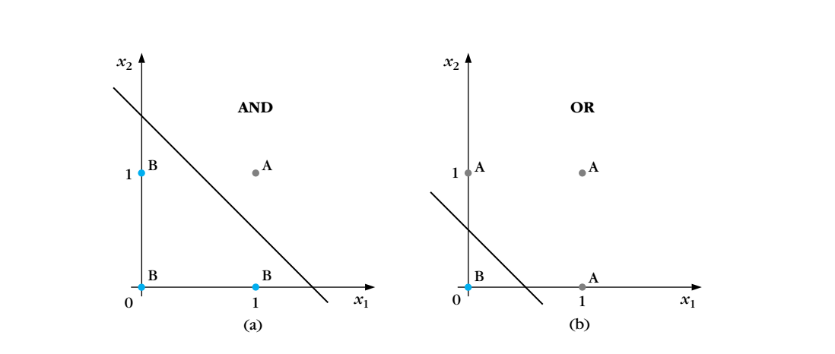
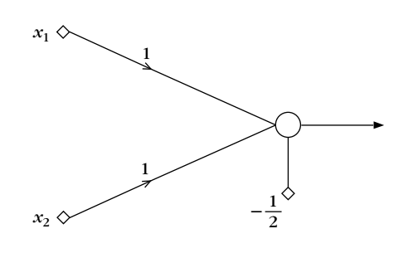
Linearly separable function
The OR gate implementation —>
If you change the bias to -1.5
it becomes an AND gate

Slide 7
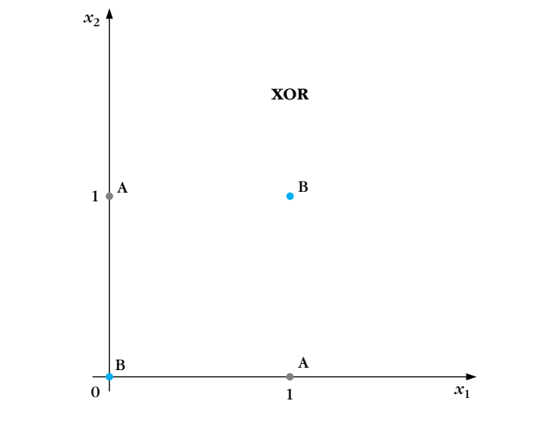
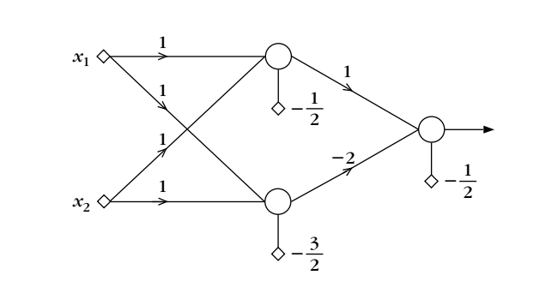
Linearly non separable function
To implement a linearly non separable function, we need multi layer
neural network. The above is the implementation of linearly
non separable XOR function

Slide 8
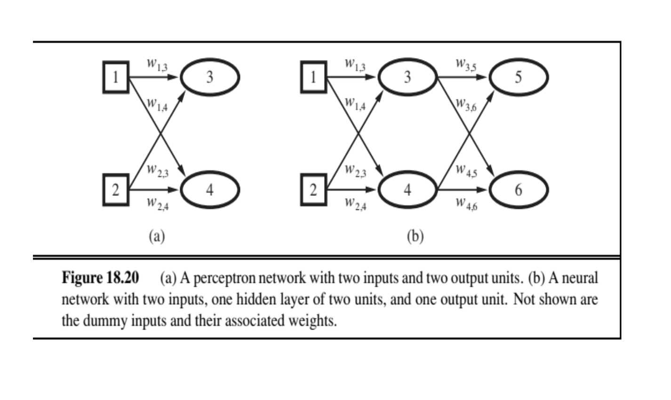
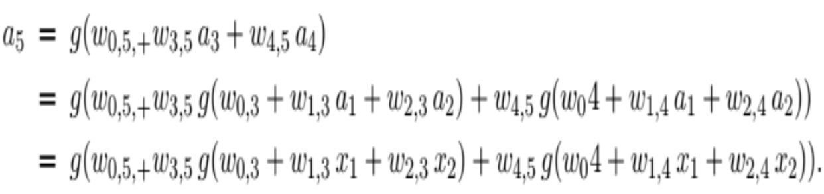

Slide 9
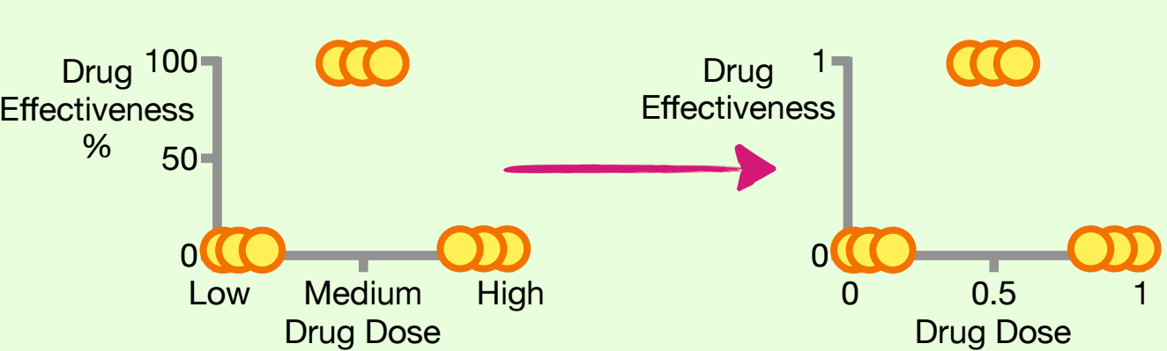

Slide 10
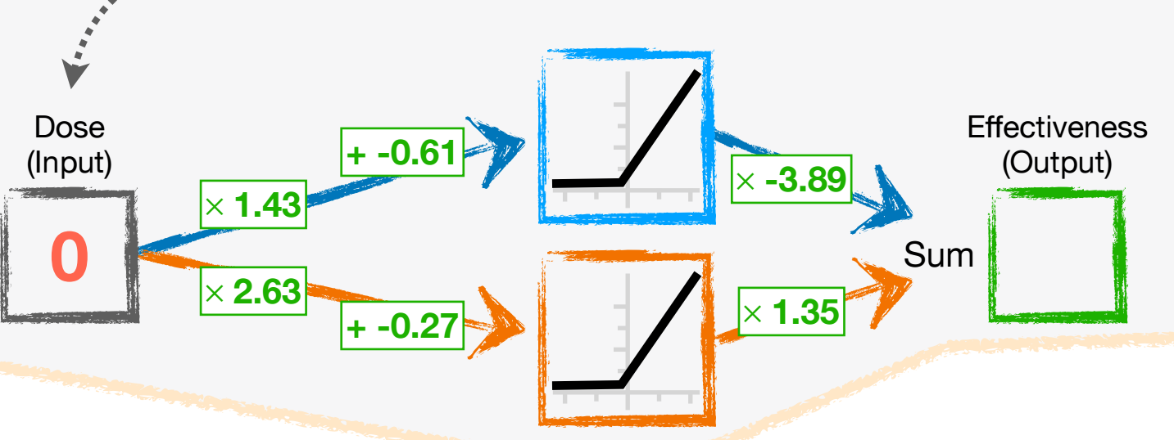

Slide 11
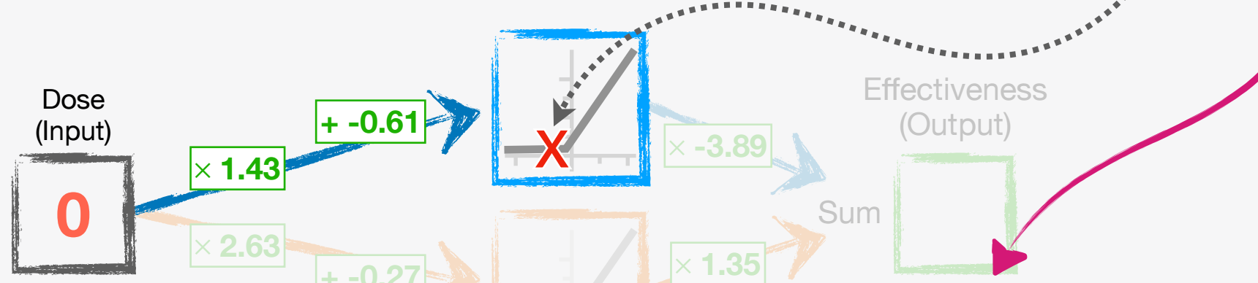
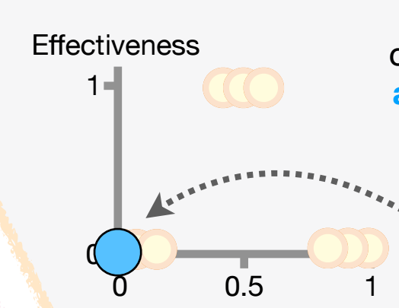

Slide 12
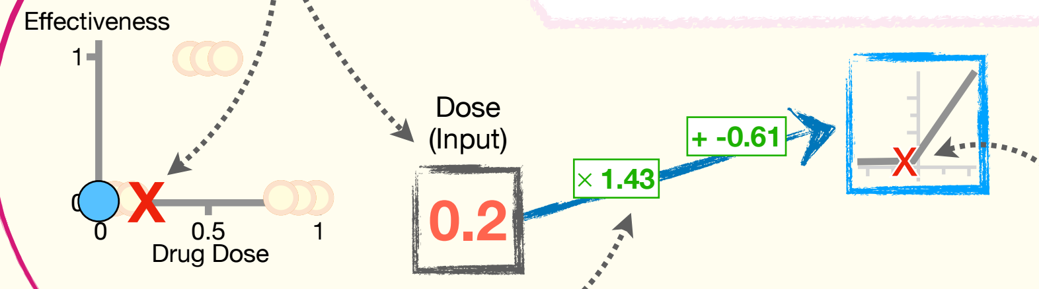
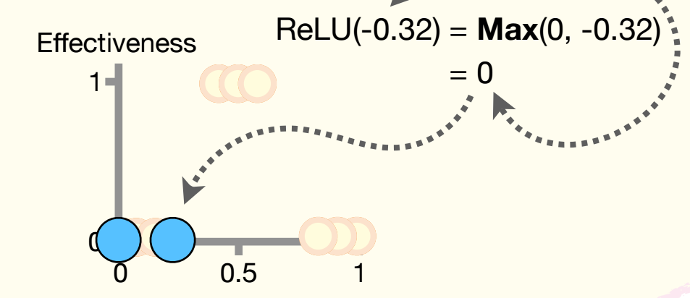

Slide 13
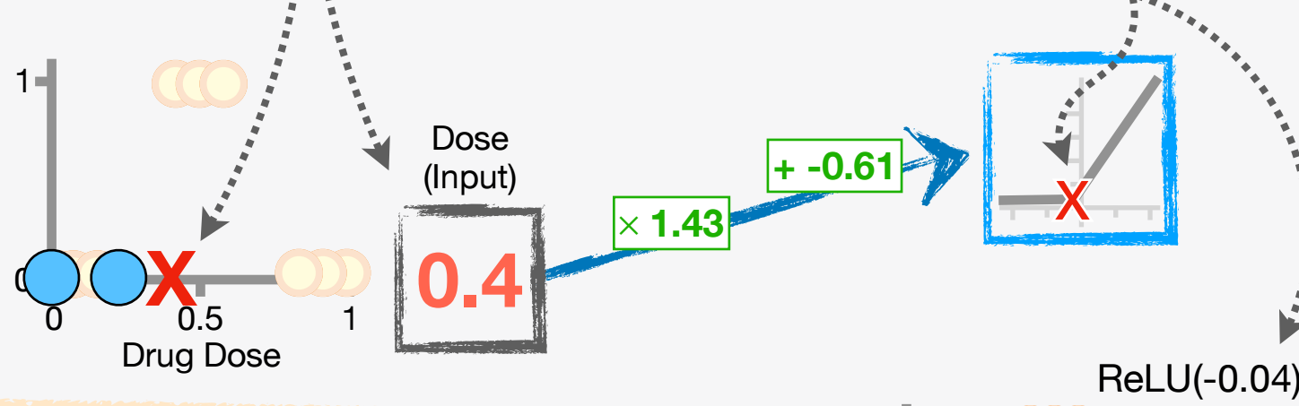
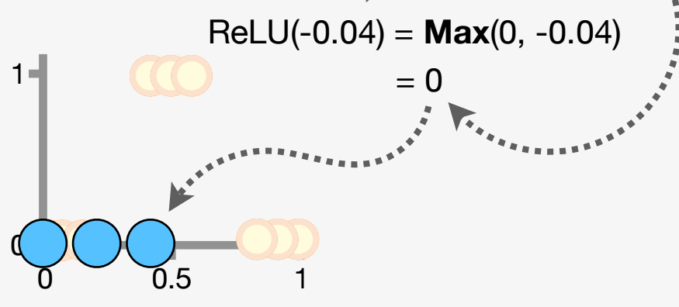
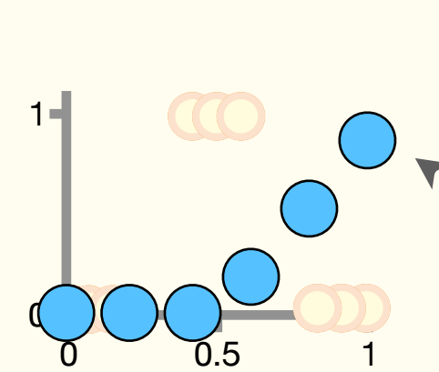

Slide 14
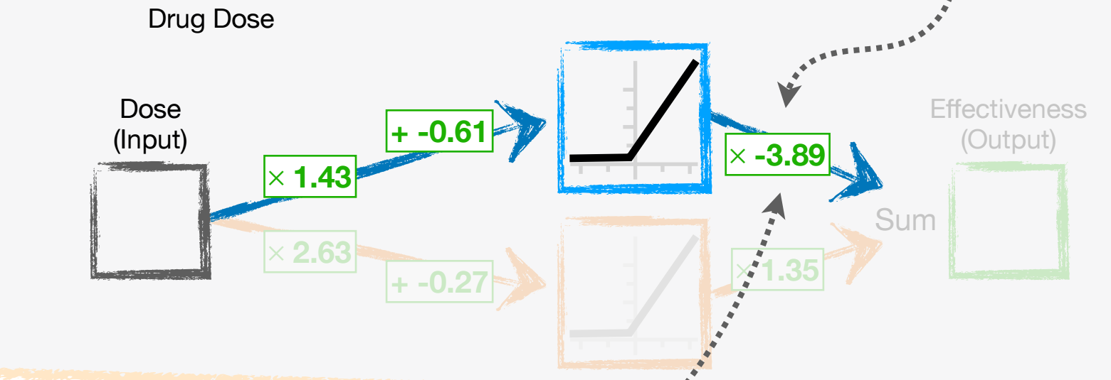
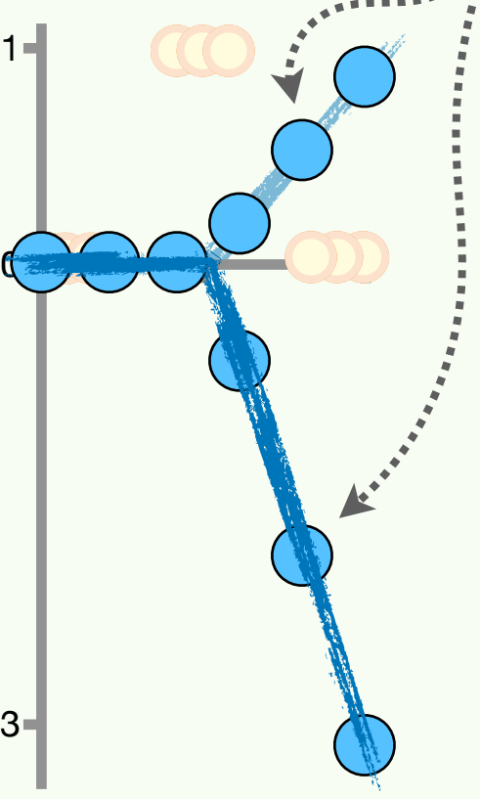

Slide 15
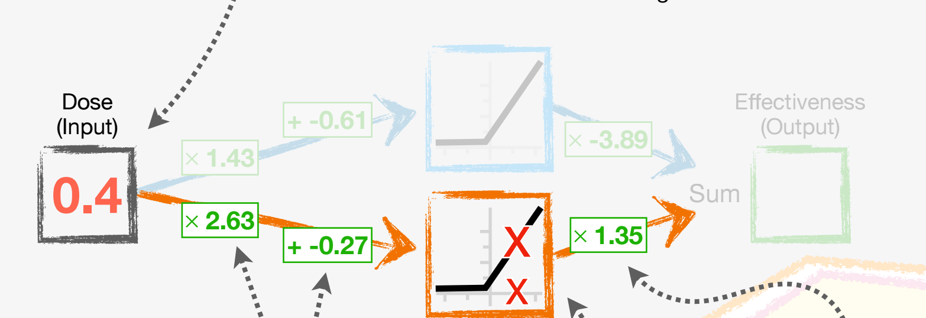
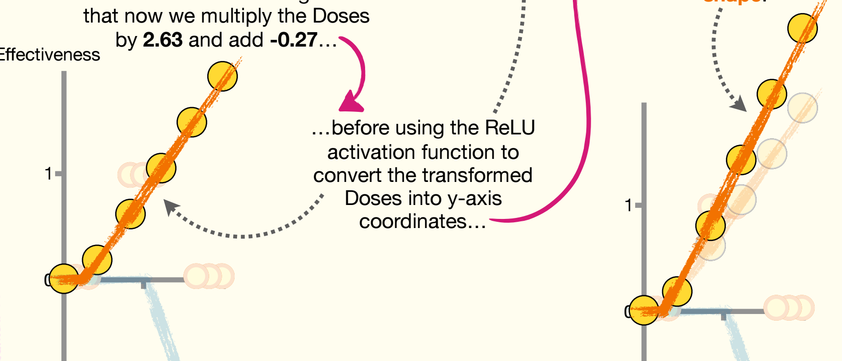

Slide 16
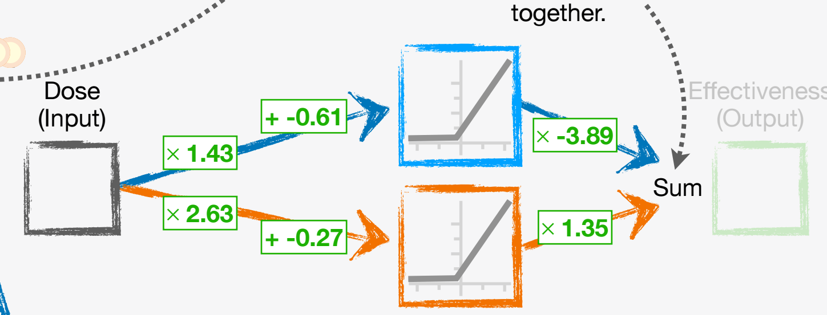
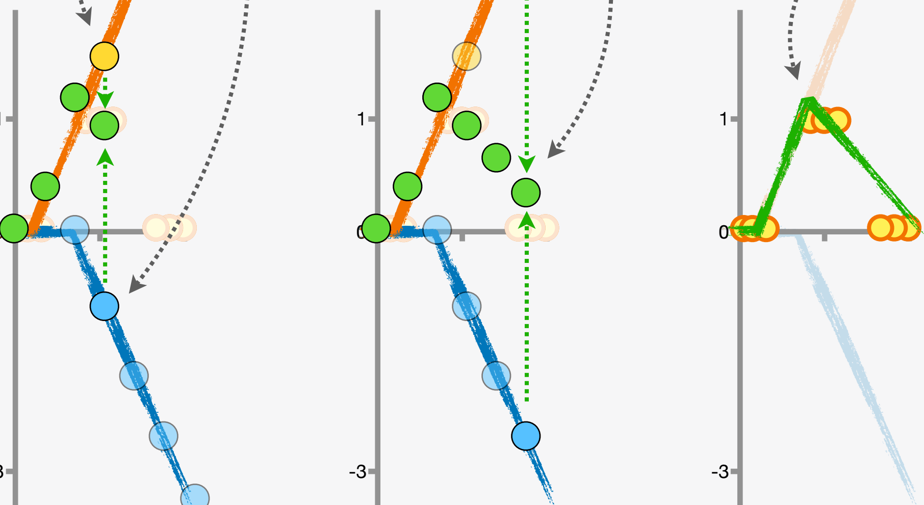

Slide 17
